Slide 1

Fable Farm

Slide 2
Developers
Edison Yang
Kevin Monahan
Jacob Weaver
Cary McLaughlin

Slide 3
Idea Phase
Merchandising Site for MN Loons
Inventory Management and Marketing Site for Farmers Market
Fable Farm

Slide 4
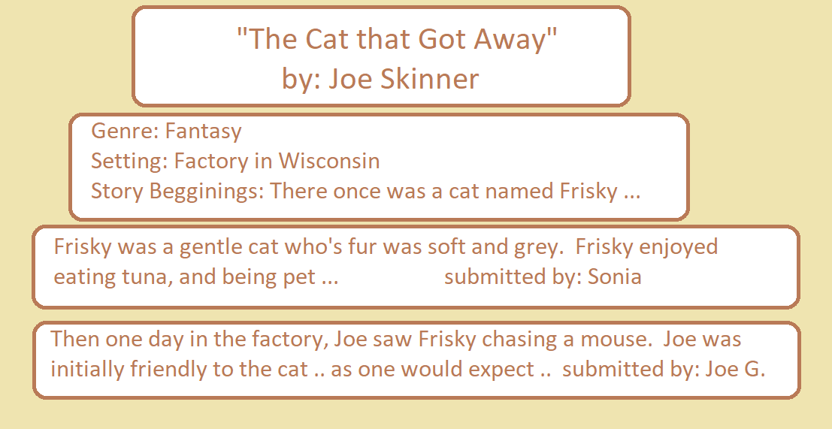
Concept

Slide 5
Specs
Uses MySQL2, Express, Body Parser
“New Tech”: Firebase Authentication & Cookie Parser
Front end: Bootstrap, Jqeury

Slide 6
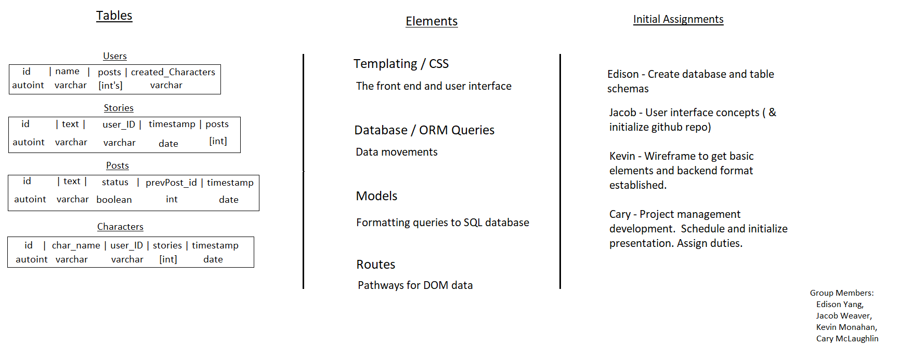
Fable Farm Initial Planning

Slide 7
Timeline
Day 1: Choose Project, Assign duties
Day 2: Wireframe, Early HTML, Routes Built, Database Started, Initial Firebase Authentication,
Day 3: Initial Testing w/ Postman, Connecting Front and Back Ends, Considering Design Flaws, Firebase Authentication Operational, Initial Cookie
Day 4: Further Testing, Front to Back End Connection, Cookies Connecting Locally, Initial Deployment, Further Testing, Final Functionality Completed, Front End Design and Logo Implemented

Slide 8
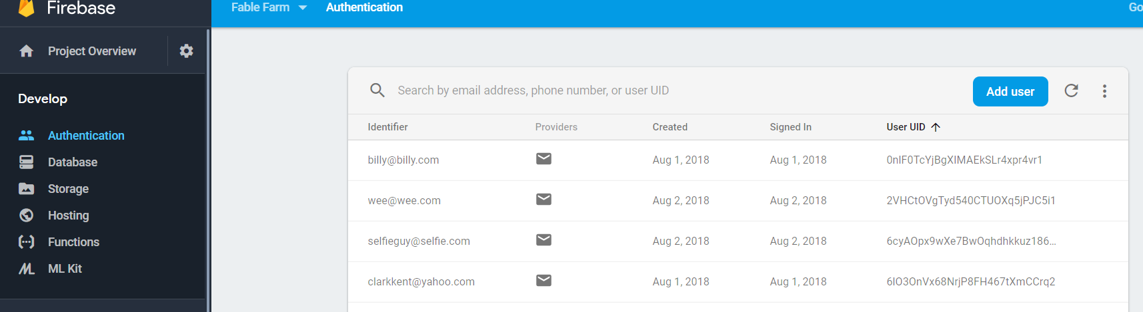
Firebase

